Slide 1
Initiative 31: Kick-Off
Towards A Single OS-Agnostic Implementation for SWT
Heiko Klare

Slide 2

Agenda
Introduction of Participants
Motivation Recap
Project Goals and Process
Project Organization
Goal for Today: Agree on a General Project Setup (Teams, Tasks)

Slide 3






Introduction of Participants
I am …
I work in … for …
I have experience in … / worked for …
I join this project because …
In my free time, I …

Slide 4
Motivation

Slide 5



SWT Modernization Goals / Constraints
Goals
Modern Look & Feel (maybe “Eclipse look & feel”)
Low(er) Maintenance Effort
High Configurability
Constraints
None/Low Effort for Adopters
Cheap Technology Dependency (cost, maintenance, runtime)
Capacities and Skillset for (Initial) Implementation Effort

Slide 6
Approaches
Range of Options with Key Properties
Replace completely with modern UI stack (e.g., web-based)
Replace with OS-agnostic graphics framework implementation
Amount of Replacement →
i.e., maintenance transfer to other technologies
From 3 to 1 SWT implementation
Update OS-specific implementations (e.g., WinUI 3, GTK 4)
Keep current OS-specific implementations

Slide 7





Benefits of OS-Agnostic Implementation
Modern Look & Feel
Eclipse Native Look & Feel
Enabler for improved configurability (only single implementation of config option)
Reduced Maintenance Effort
Only one implementation of each change
Only one implementation / OS to test
Web Integration Enabler
If runnable via web assembly
Quick (ad-hoc) product/workspace setup
Web-based view/extension integration
Attractiveness
Modern technology more attractive for motivated/skilled people

Slide 8
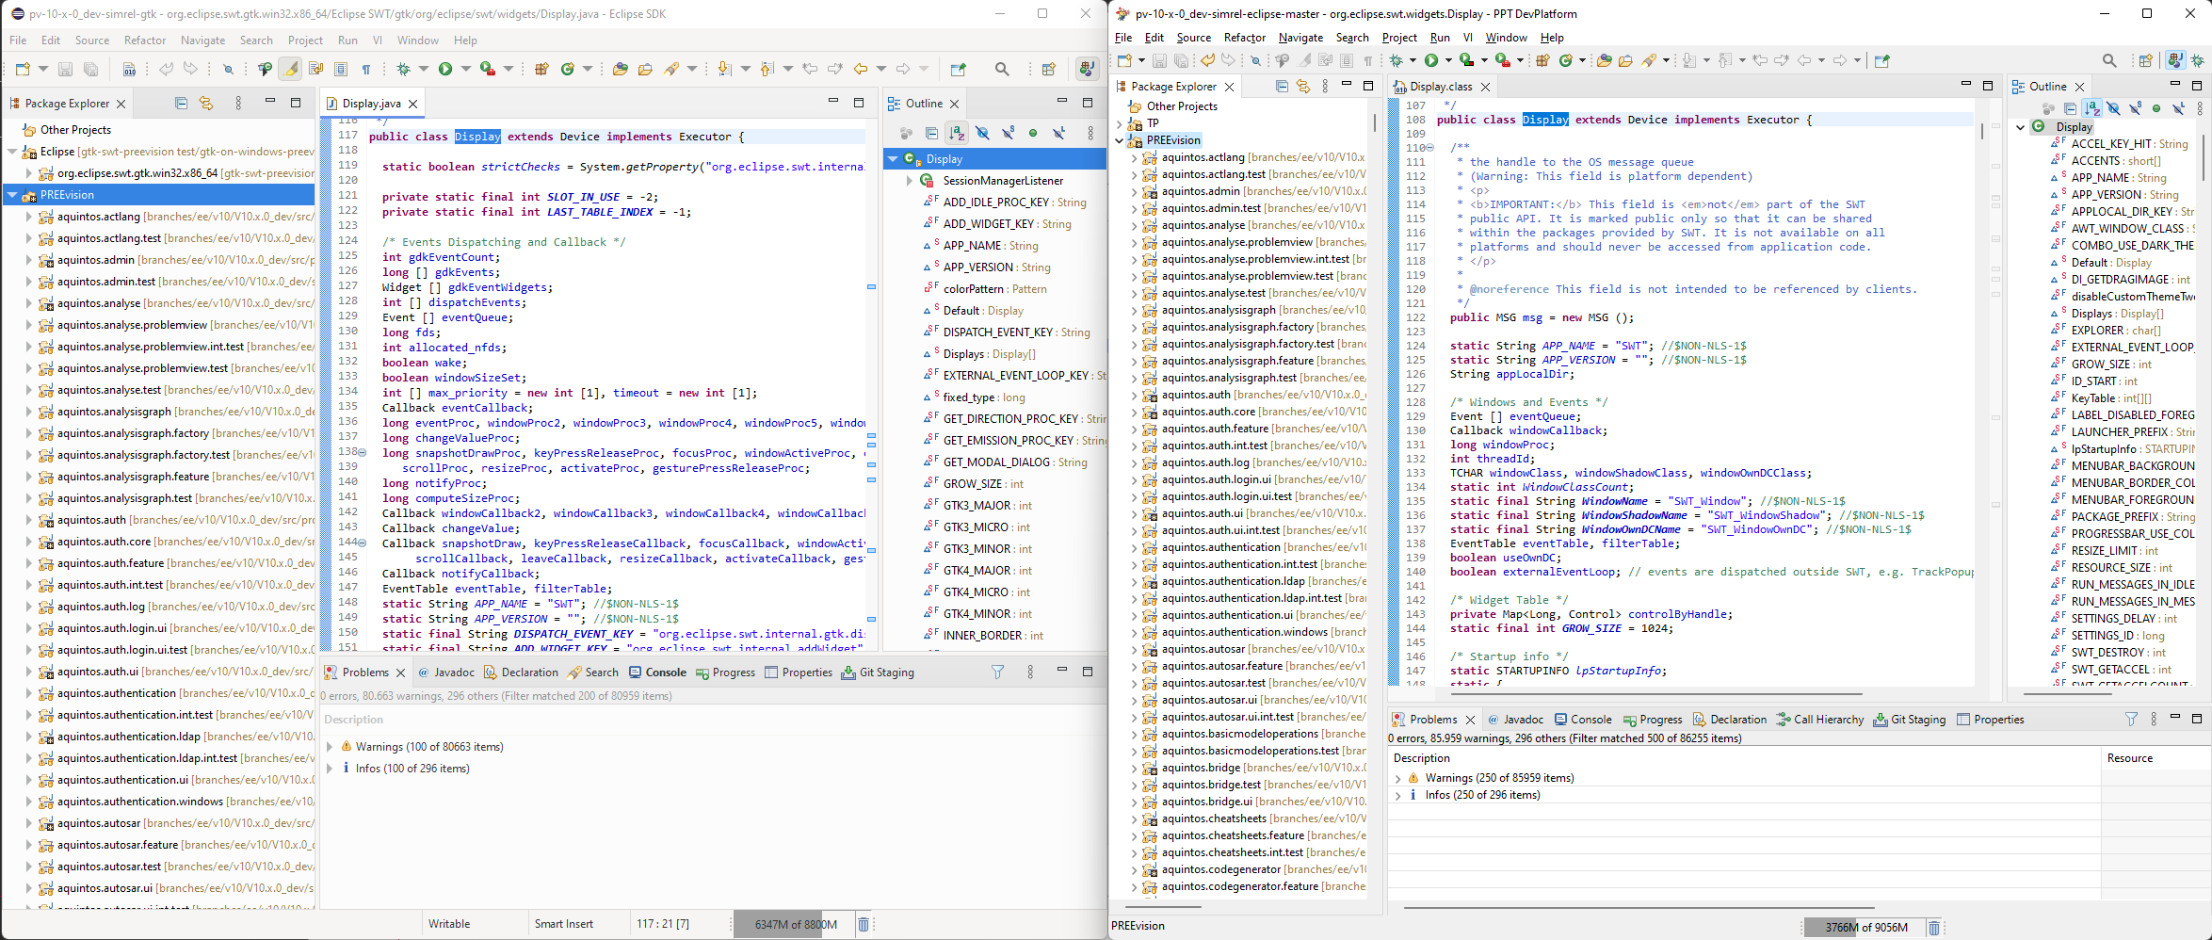
Prototype GTK on Windows: Eclipse IDE
GTK on Windows
Win32

Slide 9
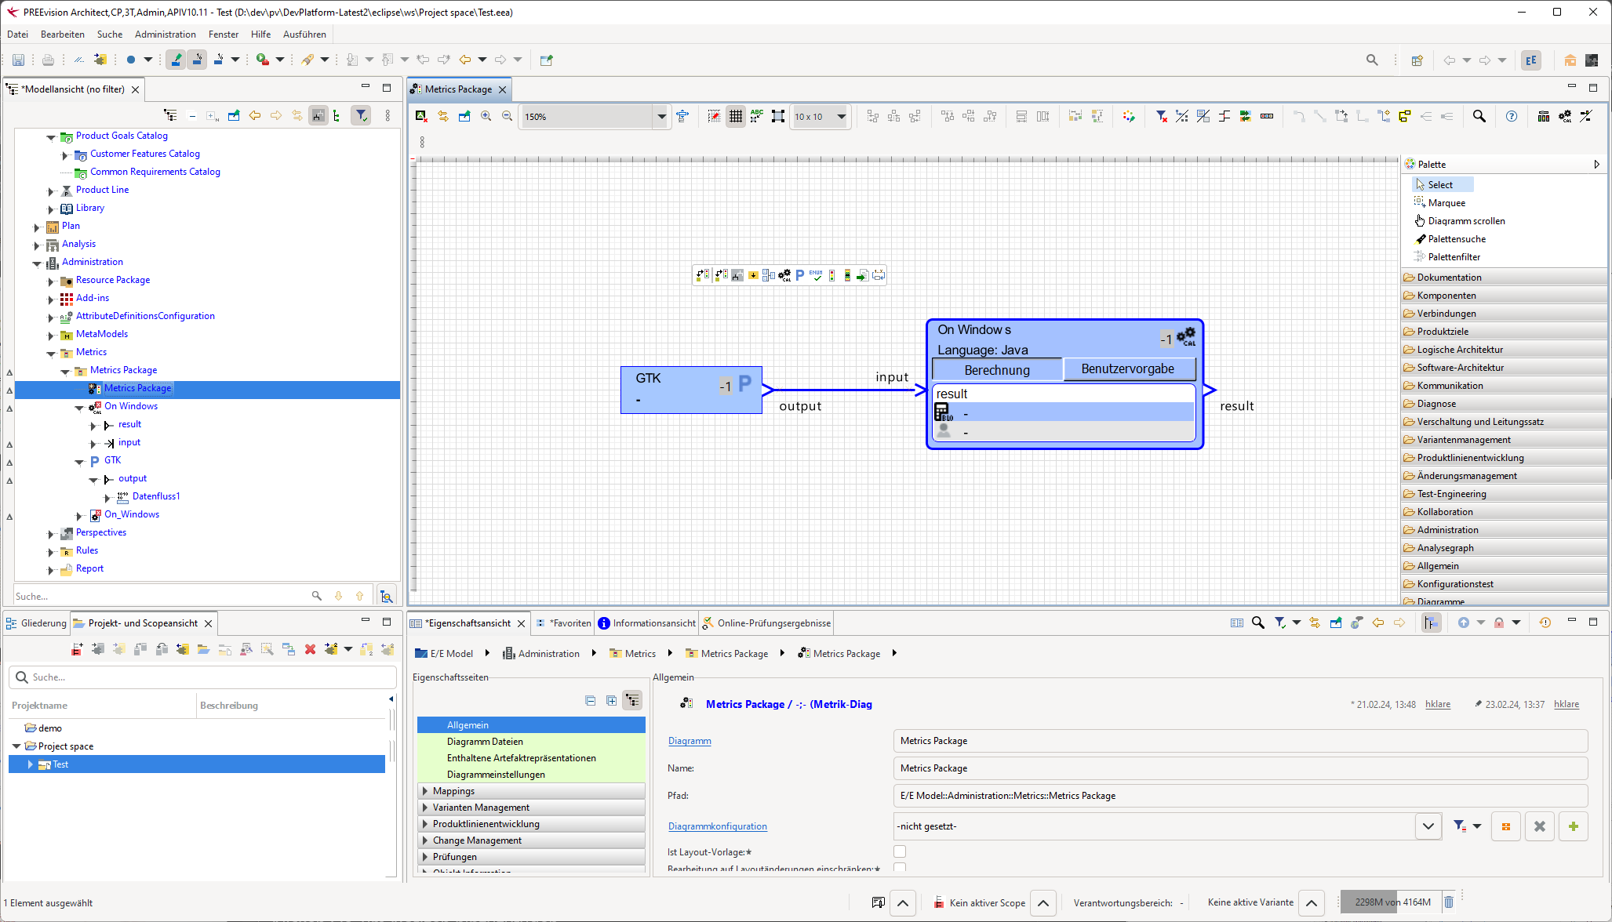
Prototype GTK on Windows: RCP Product
PREEvision (Vector Informatik GmbH)

Slide 10
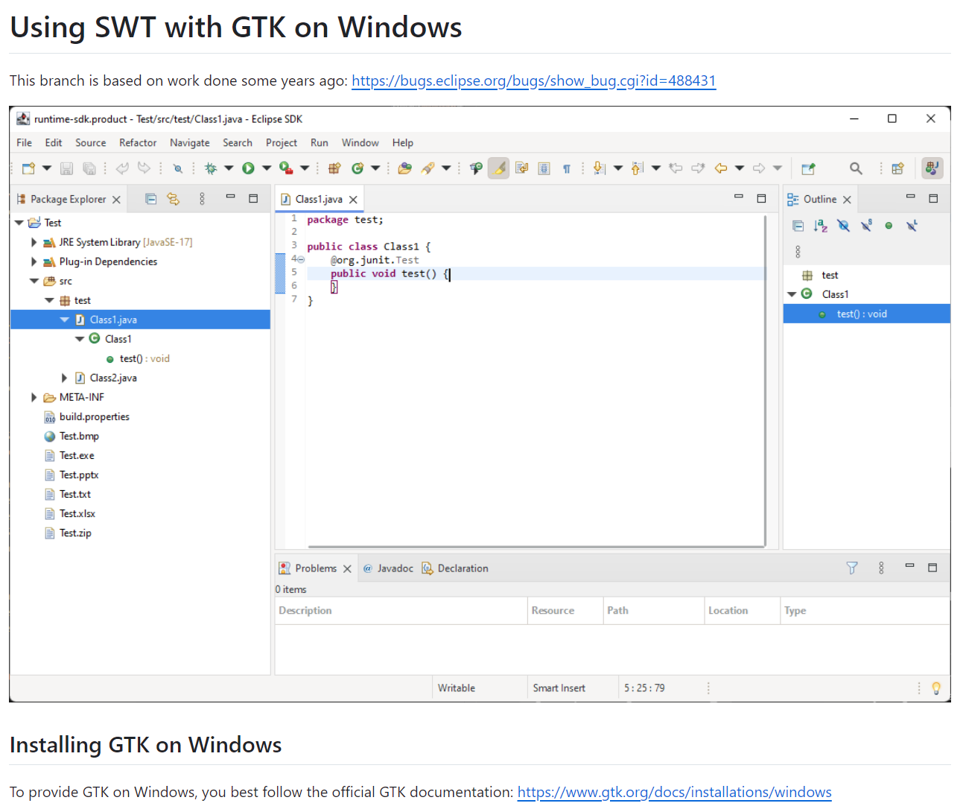
Prototype GTK on Windows: Try It Out!
Instructions: https://github.com/HeikoKlare/eclipse.platform.swt/blob/gtk-on-windows/bundles/org.eclipse.swt/Readme.GTK.Win32.md
Code Branch: https://github.com/HeikoKlare/eclipse.platform.swt/tree/gtk-on-windows

Slide 11
Project Goals and Process

Slide 12
Project Goal
Develop a 4th Eclipse/SWT implementation
… that is …
OS-agnostic
compatible with the existing API
… in order to …
enable improved look & feel
improve customizability
reduce maintenance effort (by finally deprecating/replacing existing implementations)

Slide 13
Target Technology Stack
App
Eclipse Applications, JFace, …
SWT
SWT API
OS-Agnostic SWT Graphics/Widgets
SWT Win Fragment
SWT Mac Fragment
SWT Linux Fragment
Lib
OS-Agnostic Graphics/Widgets Framework
OS
Win32 (OLE/COM/…)
MacOS Cocoa (Foundation/…)
POSIX (Glib/DBUS/IO/…)

Slide 14
Project Phases
Prototypes
Prototypes
Techn. 1
Techn. 2
Techn. 2
Techn. 3
Mature, Maintained SWT Implementations
Techn. 2
Mature, Maintained SWT Implementations
Mature, Maintained SWT Implementations
Mature, Maintained SWT Implementations
MacOS
MacOS
MacOS
MacOS
Windows
Windows
Windows
Windows
Mature, Maintained SWT Implementations
Linux
Linux
Linux
Linux
Techn. 2
Current
Prototype
Realization
Production
Replacement

Slide 15
Prototype Phase
Avoid the potential “difficult-to-implement” last 10%
Key Questions
Is technology X suited for the project’s goal?
Which of the suited technologies best fits for the project’s goal?
Required Inputs
List of technologies to investigate
List of criteria to decide when technology is suited
Prototype Phase = Research Phase
Probably, only 1 of X technologies will be further investigated afterwards
Prototypes must only serve validation purpose → no need to meet product quality
Still, the evaluation of every technology is valuable and necessary to achieve the project goal

Slide 16
Prototype Phase: Criteria
Functionality
Java bindings / usable from Java
Integration of browser (possible)
Can fulfill existing API (even OS-specific one):
Support for multiple Display instances (exists for Windows)
Embedding of native window handles
Embedding of AWT/Swing widgets
Optional: Executable in browser (WebAssembly)
Quality
Open source, compatible license
Actively maintained, widely adopted
Mature at least on Win, Linux, Mac
Critical / Difficult Points
Integration of SWT event loop
Uncommon object hierarchy direction
Custom widgets impact (e.g., Nebula)
TextLayout / StyledText (highest complexity)

Slide 17
Prototype Phase: Technologies Overview
Preselection of technologies based on paper-based evaluation of criteria
Collection process:
Systematic web search
Wikipedia lists: Widget toolkits, Graphics libraries
Exclusion criteria:
Non-cross-platform
Web-based stacks
Commercial license
Low adoption
Outdated
Immature (most difficult to decide)

Slide 18
Prototype Phase: Technologies Selection
Technology | Properties
Skia (low-level graphics) with VCL / LibO widgets | Skia: widely and further adopted graphics library LibreOffice, Chrome, Firefox, WebKitGTK, Uno Platform, … Widget framework options: Visual Class Library (VCL) by LibreOffice Flutter (quite young, fast evolving) Maybe easy integration with other Skia-based tools
GTK (widget framework) | Available for all major OS (ports for Windows and MacOS) Low risk as SWT implementation already exists (GTK 3) Prototype with SWT fragment combining GTK and Win32 exists
Swing (widget framework) | Purely Java (easy deployment, Java-native platform independence, developer availability, …) Supported by Oracle and used by JetBrains (IntelliJ) Good customizability (HiDPI, vectorized icons etc.) Prototype “SWTSwing” was already under development
Initial proposal as result of a “paper-based” evaluation

Slide 19
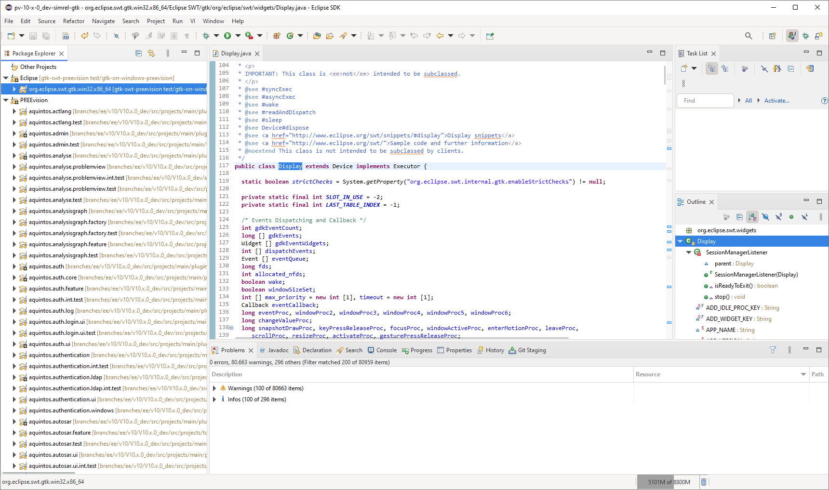
Technology Candidate: GTK
Major Benefits:
SWT implementation exists → low-hanging fruit
Native customizing via CSS, themes available
GTK4 implementation required anyway
Ports
Windows
GTK 3 and 4 available
Maps to Win32 API
Prototype available
MacOS
GTK 3 and 4 available
Uses Quartz backend (X Windows Server Port)
Support improved with GTK 4
Installable via homebrew

Slide 20
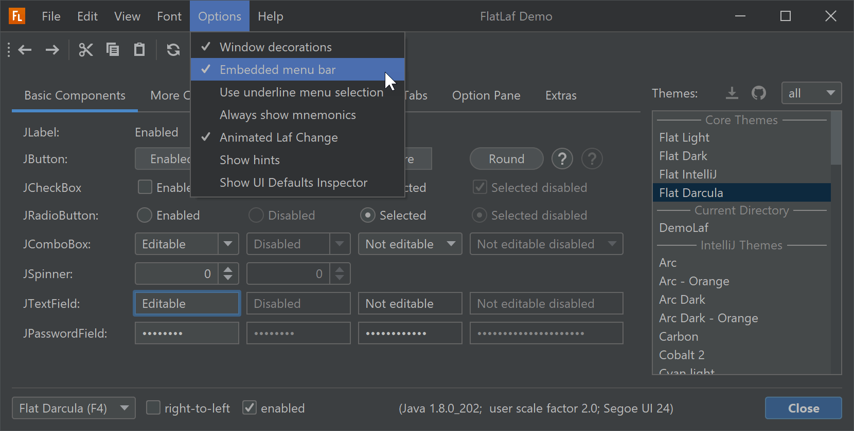
Technology Candidate: Swing
Major Benefits
Purely Java
Java-native platform independence
Easy deployment
Developer availability
Used by IntelliJ / maintained by Oracle
Customizable look & feel, existing themes
Existing Prototype SWTSwing
Eclipse Issue Tracker, Eclipse Forum
Oracle Java Client Roadmap (2020)
”Swing and AWT: AWT has been an integral part of Java SE since its launch in 1995. Swing was introduced shortly thereafter as a separate library and finally incorporated into “J2SE 1.2” in 1998. Both toolkits are part of the Java SE Specification and core to many other toolkits and applications that build on top of them.
Oracle will continue developing Swing and AWT across all supported releases as a core Java SE technology.”

Slide 21
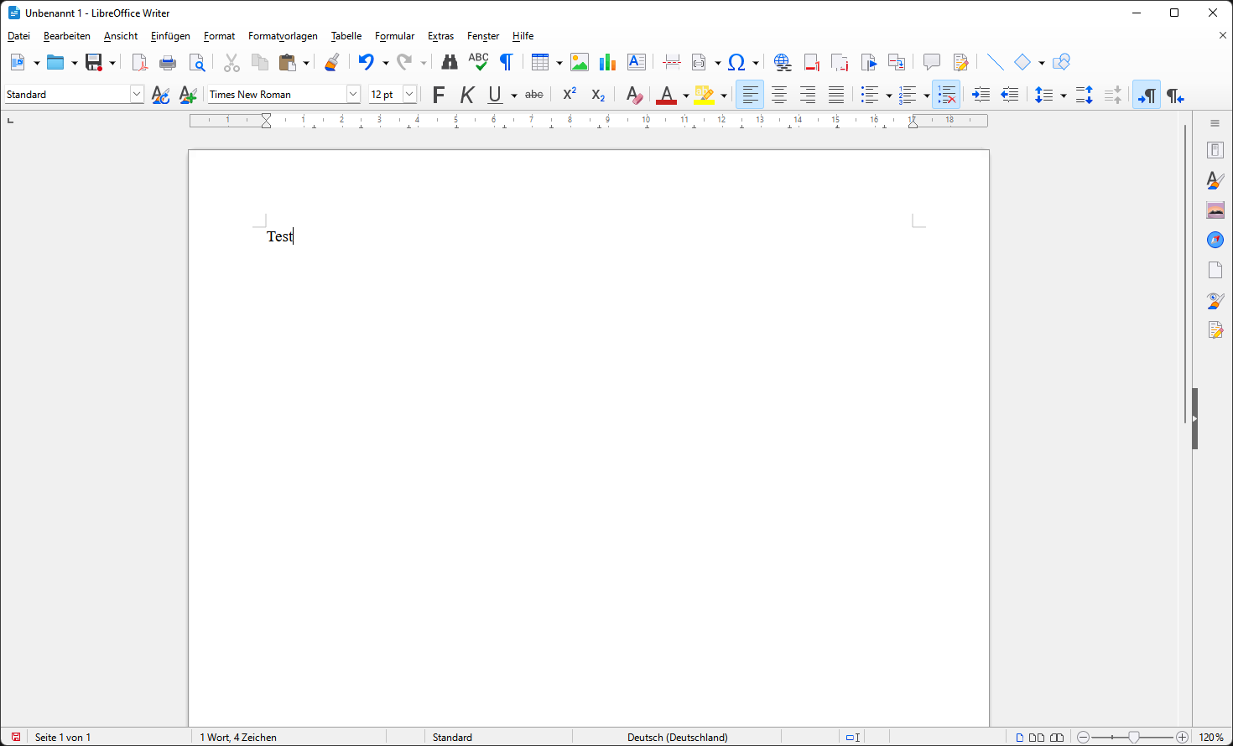
Technology Candidate: Skia with VCL
Major Benefits
Fast, widely adopted graphics library
Enabler for WebAssembly deployment
Potential combination with other Skia-based products
Consider high update frequency
Widget Frameworks
Visual Component Library (VCL) from LibreOffice
Library is open source
Shared efforts with LibreOffice
Possibility of integration with LibreOffice
Alternative Candidate: Flutter
Risk: young, fast evolving

Slide 22
Prototype Phase: Evaluation
Outcome: Assessment of technologies with respect to key questions:
Is technology X suited for the project’s goal?
Which of the suited technologies best fits for the project’s goal?
Used by WG companies to choose best fitting one to realize
Remarks:
We (prototype developers) will not make the decision but provide the necessary information to make an educated decision
There will not be a “winner technology”, it is all about an objective evaluation for the goals defined in the beginning

Slide 23
Project Organization

Slide 24
Collaboration Principles
We jointly and equally work on a common goal
We are from different companies with
different backgrounds,
different experiences, and
different ways of working and thinking.
We need to find out, discuss and define how to best collaborate
If anything bothers you or if you are not feeling well in the setup, talk to your supervisor, Johannes, Federico, Heiko, …
Every contribution is valuable and necessary to achieve the common goal → there will not be “loser” and “winner” technologies

Slide 25
Participants
People in italics have rather supervisor/coordinator/consultant roles
Renesas | Bosch/ETAS | SAP | Vector | IBM
Theo | Vrinda | Michael | Federico | Betty
? | Latha | Denis | Heiko | Niraj
William | ? |  |  | Andrew
 | Ruediger

Slide 26
Development Process Proposal
We have two evaluation dimensions
Technologies
Multiple teams: one per technology
Maybe (but not necessarily) by company
Efficiency: team becomes expert for that technology
Criteria
Multiple increments: one per criteria
Allows for iterative / agile process
Fast feedback and risk management: If an increment is unsuccessful (i.e., if criteria cannot be fulfilled), technology can probably be dropped

Slide 27
Development Increments Proposal
Each technology will have own set of reasonable increments/milestones
Common pattern could be as follows: (developed on a single, arbitrary OS and in parallel be made working on other OS as well)
Technology set up independently with some demo project
Working SWT Snippet1 (only show Window)
Working SWT Snippet116 (Textbox + Button)
Working demonstrator with multiple SWT Display instances
Working embedding of other window handles (Windows native / AWT)
Working demo browser
Working SWT ControlExample
Working SWT CustomControlExample
Working Eclipse SDK product
These are not necessarily part of a prototype (but might at least be of interest for GTK)

Slide 28



Development Teams Proposal
Expected effort
Team GTK
Implementation exists: focus on SDK instead of snippets
Can also invest into the GTK 4 implementation
Team Swing
Can try to reuse leftovers from SWTSwing project
Can start without any libraries, ports etc.
Team Skia
Has to set up Skia and extract VCL examples first
Has to embed native Skia/VCL code
Proposal: 2 People
Proposal: 2 People
Proposal: 3-4 People

Slide 29
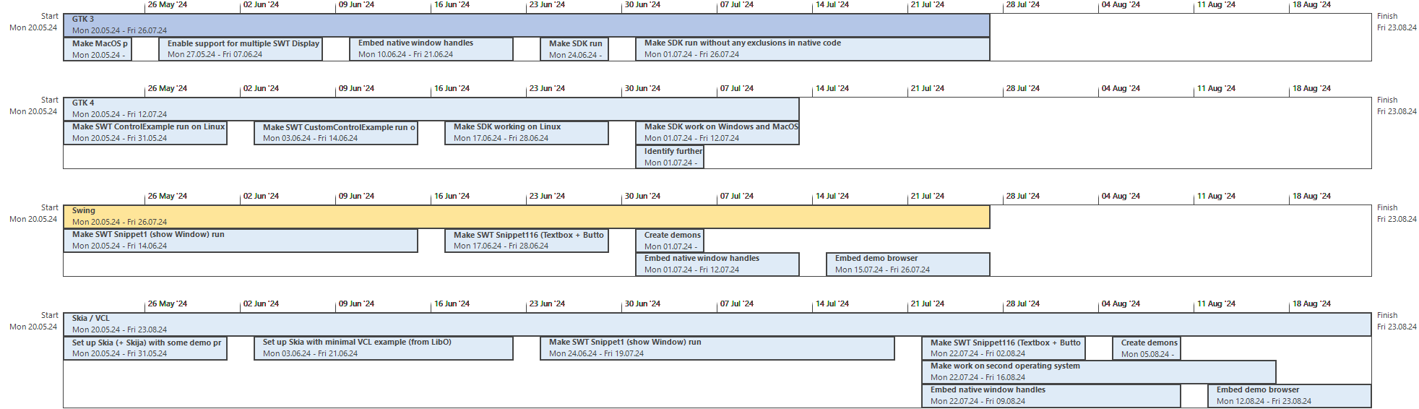
Initial Project Plan Proposal
You will find a list with the tasks and dependencies in the appendix

Slide 30
Organization in Teams
Overall Task: Answer key question 1 “Is technology X suited for the project’s goal?”
It is up to each team to organize itself
Working on increments would be good for cross-team exchange
Wish for a first team meeting:
Define your “team rules”: Which values are important for you?
Share these rules with the whole group so that we have a joint list of what is important for all of us

Slide 31


(Cross-Team) Coordination
Agreement in kick-of meeting: role taken by Heiko
“We jointly and equally work on a common goal”
Still, we need some kind of coordination across the teams
Formats: (Primarily) online meetings
Progress exchange: weekly meetings with all teams
Personal exchange: maybe informal coffee/beer meetings?
Persons:
At least a cross-team coordinator for
organizational topics (progress tracking, risk management, meetings etc.)
technic-technological topics (setup issues, architectural decisions etc.)
Technical expertise should primarily be established in the teams
Fridays, same time as today?
What do you expect here?

Slide 32
Team Composition
Initial assignment from kick-off meeting
Team GTK
?
?
Team Swing
?
?
Team Skia
?
?
?
Proposal: 2 People
Renesas
Bosch/ETAS
Proposal: 2 People
Proposal: 3-4 People
SAP
Vector

Slide 33
Looking Forward to Working With You!

Slide 34
Appendix
Collection of Additional Information

Slide 35
Why to Rethink the SWT Implementation
Outdated Look and Feel
Particularly on Windows (> 20-year-old API)
Different appearance on all OS (native)
Difficult / Expensive Maintenance
Technical debt
Low code quality
Lack of experienced developers
Lack of people willing to learn
Complexity
Everything must be implemented and validated for three OS
OS-/version-specific tweaks
Limited Configurability
“Lowest common denominator” of OS APIs
Difficult to improve overall UI
Limited configurability / branding
Notes:
Mismatch between primarily Linux SWT developers and primarily Windows SWT users/adopters

Slide 36
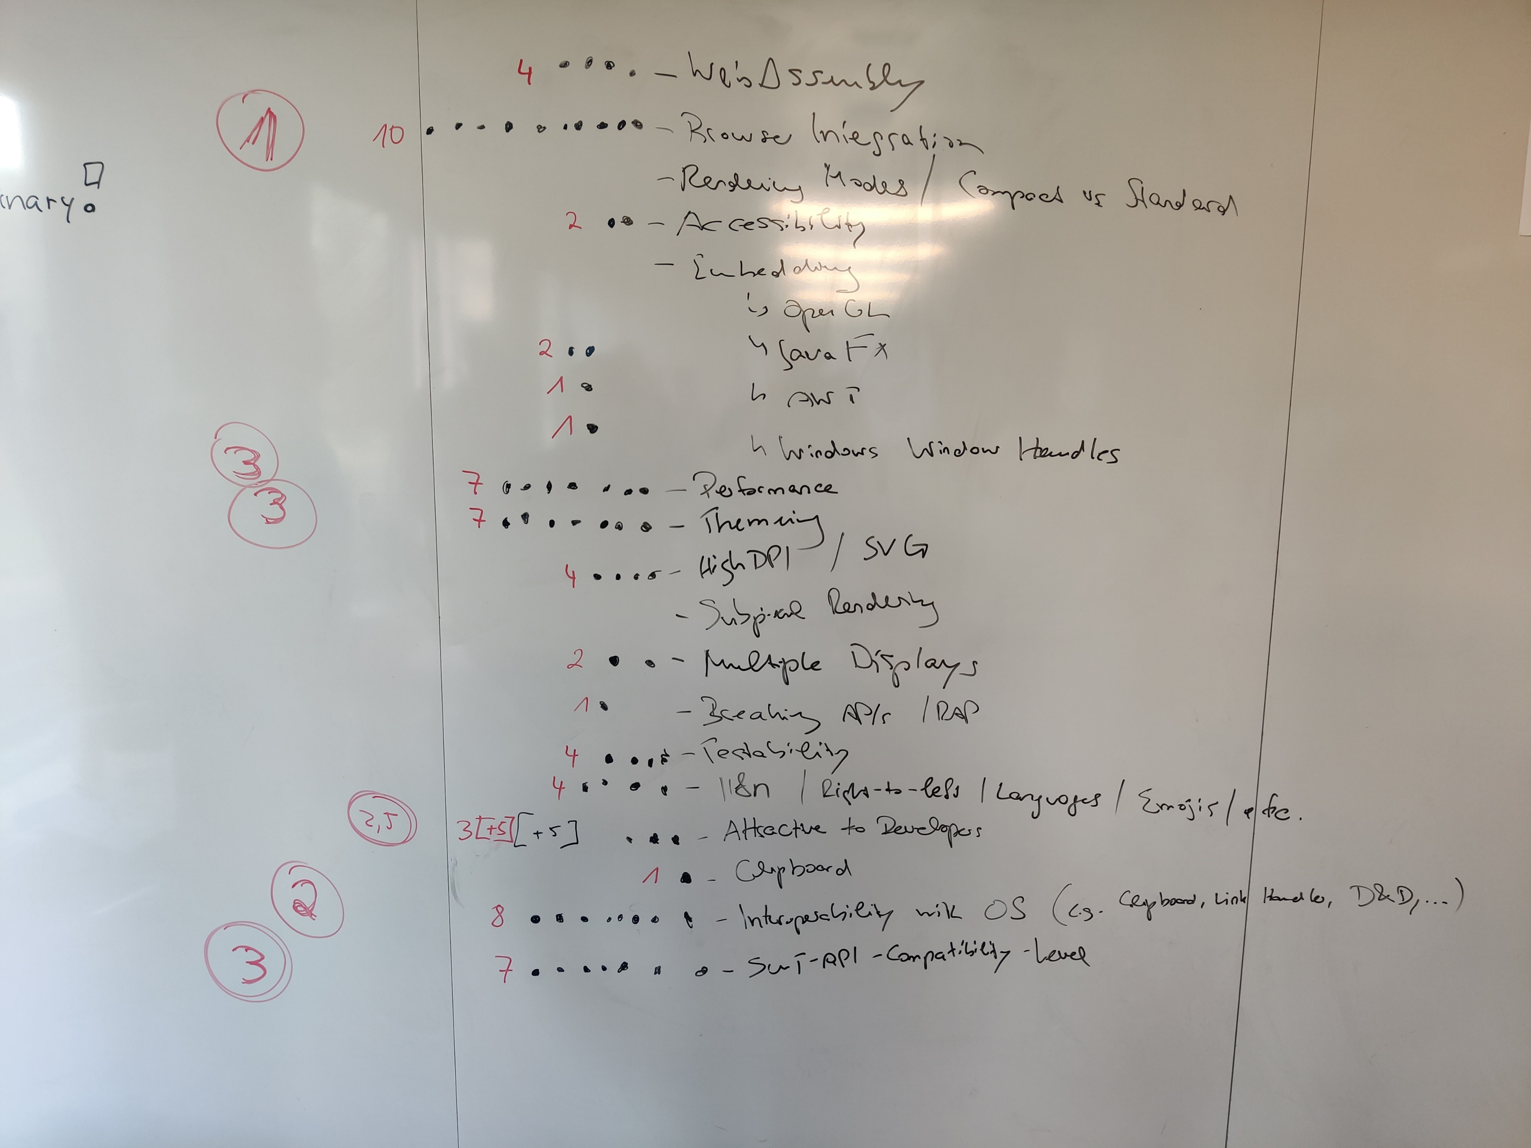
Criteria Collected at IDE WG Meeting
Eclipse IDE WG meeting 27th Feb 2024
Collection Process
Brainstorming of criteria
5 dots per participant for rating criteria of highest importance
Numbers in circles indicate priority order resulting from dots
Remarks
List may be incomplete
List combines …
Features that must just be implemented
Features that must be provided or enabled by the technology
↑ these must be evaluated in prototypes

Slide 37
Technologies: Exclusion List
Specific Candidates
QT
Widely adopted, but risk of release again only under commercial license
Fyne
Modern, but not yet mature
Only adopted by FyneDesk (linux desktop)
Flutter
Rather new and particularly for responsive, also mobile applications
Abstract Window Toolkit (AWT)
Uses native widgets → platform-dependent
Primitive and less flexible compared to Swing
wxWidgets
Abstraction for native APIs, just like SWT Several tools, but not really widely adopted
Java bindings outdated (2013)
Outdated
CEGUI
FOX toolkit
XForm
XVT
Clutter
JavaFX
Low Adoption
Elementary
IUP
Tk
FLTK
Juce (commercial license)
U++

Slide 38
Additional Information
WebAssembly (from Manuel Bork)
CheerpJ: Java WASM on HTML, but proprietary, used more commonly for interacting with legacy Java 8 code from modern web frameworks
Perhaps WASM is not even the right direction. This is a good paper on comparing WASM JVM solutions
Learnings from other tools
Chrome, Firefox, LibreOffice use Skia (LibreOffice migrated from Cairo)
IntelliJ Fleet uses Noria (reactive framework like React or SwiftUI) on Skia
IntelliJ IDEA: UI refresh in 2022, still based on customized Swing (now looking like VSCode), but mainly pure Swing components
NetBeans uses Swing

Slide 39
Increments Proposal: GTK 3/4
GTK 3 steps completely parallelizable
GTK 3
Make MacOS port run SDK
Enable support for multiple SWT Display instances
Embed native window handles
Make SDK run without any tweaks in SWT code
Make SDK run without any exclusions in native code
GTK 4
Make SWT ControlExample run on Linux
Make SWT CustomControlExample run on Linux
Make SDK working on Linux
Make SDK work on Windows and MacOS
Identify further tasks for GTK 4 implementation

Slide 40
Increments Proposal: Swing
Make SWT Snippet1 (show Window) run
Make SWT Snippet116 (Textbox + Button) run
Create demonstrator with multiple SWT Display instances
Embed native window handles
Embed demo browser

Slide 41
Increments Proposal: Skia/VCL
Set up Skia (+ Skija) with some demo project
Set up Skia with minimal VCL example (from LibreOffice)
Make SWT Snippet1 (show Window) run
Make SWT Snippet116 (Textbox + Button) run
Create demonstrator with multiple SWT Display instances
Embed native window handles
Embed demo browser
In parallel after step 4: Make work on second operating system
Can be started after 3.

